Slide 1
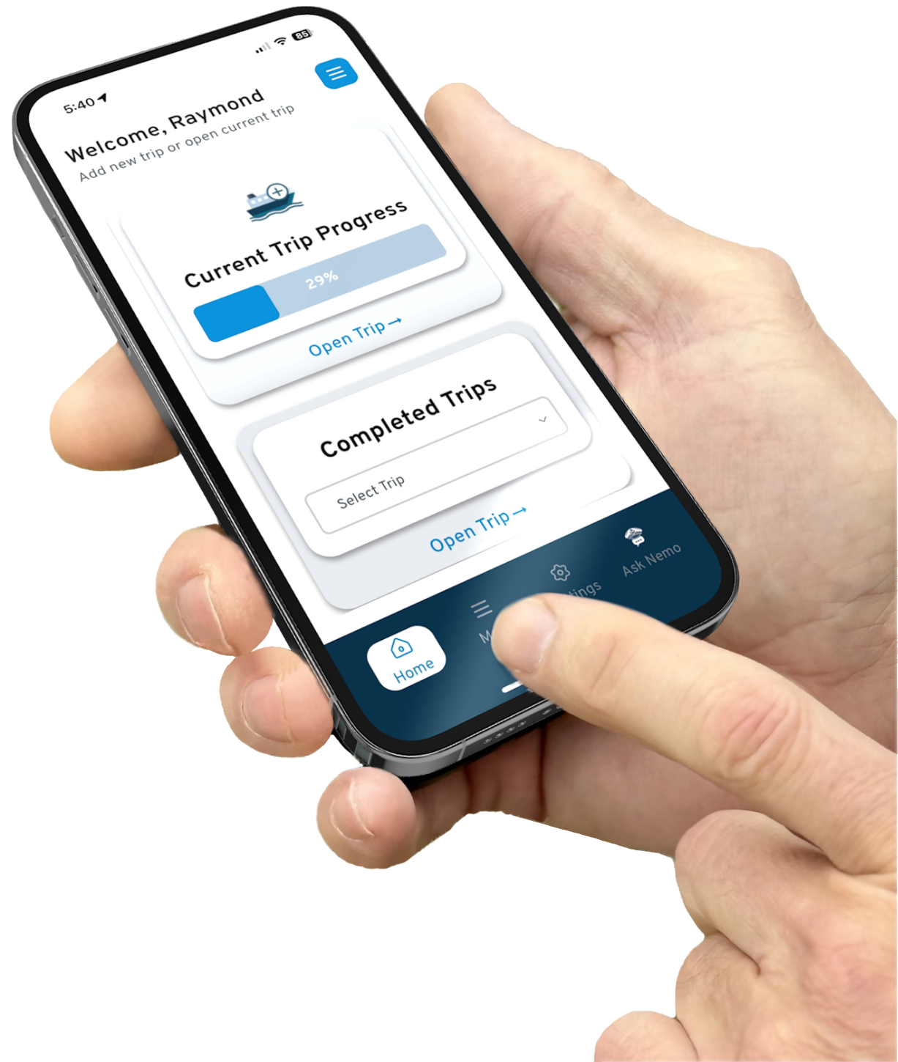

CAPTAINS
ELOG
Proudly developed with PEIFA, Captains elog is an electronic logbook for fishermen qualified by Fisheries and Oceans Canada (DFO) for fishers in Canada.

Slide 2
WHO WE ARE

Slide 3


Captains elog is proudly developed by socilogica Technology Ltd. with PEIFA

Slide 4

Proudly Canadian built and operated
Dedicated to the highest standards of data security
Committed to keeping app cost low

Slide 5
KEY FEATURES

Slide 6

Not web based
Works on android/apple phone/tablet
One price includes all personal reports and helpdesk
Robust help desk available at convenient times
Only data mandated by DFO is collected
Powerful in-app assistant: Nemo
Sync data to several devices

Slide 7
OUR EXPERIENCE
Prior to Launch

Slide 8
DFO approved electronic logbook
Paper Logbooks no longer accepted by DFO in Gulf Region
New information collected for the Gulf Region in elog:
Coordinates
Bait
Personal consumption

Slide 9
Getting fishers prepared for electronic logbooks:
Built a hands-on training program
Developed a step-by-step guide: downloading/ registering
Developed an illustrated step by step guide for app use
Created “how to” videos
Provided a free trial to allow fishers to test the app

Slide 10
OUR EXPERIENCE
After launch (Mandatory compliance in Gulf Region in 2025)

Slide 11
47 % of users reached out for assistance
Questions focused on user error /not app function
Those who participate in training had better experience
Peak period for helpdesk; first 3–4 weeks
Significant app update in week 4 – based on fisher feedback
Helpdesk support requests fell off significantly after week 4
DFO enforcement

Slide 12
OUR EXPERIENCE
Maritime Region

Slide 13
Although not mandatory for 2025/2026 winter season there is interest from fishers in trialing the app
Training conducted in NB and NS to introduce Captains Elog
Need to commit to at least a month at a time, to trial
Page #2 – to be addressed in the app - until then, those trialing to submit a copy to DFO
Where elogs are voluntary in the Maritime Region, we are offering a free trial of our app for the 2025/2026 season

Slide 14
KEY TAKEAWAYS

Slide 15
Fishers need to be informed well in advance of mandatory compliance
Resistance to change – technology, information
Concerned with data security, want to understand the data to be collected and why
Preparation is key:
Hands on training - more meaningful when fishers work along with the trainer
Support resources available (visual step by step guides)
Helpdesk support
55% of users participate in training – shared their knowledge
Time and practice = success

Slide 16
THANK-YOU
FIND US:
www.captainselog.com
IG & FB: captainselog
hello@captainselog.com
Tel: 1-866-855-2001

