Slide 1

Transport Canada
Fishing Vessels and Aquaculture
Fish Harvesters Forum

Slide 2
Introduction – What is a Fishing Vessel?
From the Fishing Vessel Safety Regulations (FVSR)
Fishing vessel means a vessel that is used or is to be used for commercially catching, harvesting or transporting fish or other living marine resources.
Aquaculture (if not acting as a workboat or passenger vessel)
Lobster / Crab
Oyster
Mussels
Rockweed
Sea Cucumbers
Etc.

Slide 3
Introduction - What’s New?
Phase I of the Fishing Vessel Safety Regulations amendments, was published in the Canada Gazette, Part II on July 13, 2016, and came into force on July 13, 2017.
Phase II of the FVSR amendment is currently under way and is expected to be in Canada Gazette part I, in late 2026. (Construction)
The new Fishing Vessel Safety Regulations are a result of extensive consultation with stakeholders, including fishing vessel owners, provincial and territorial safety groups and representatives of fishing safety associations from coast to coast to coast.
Regulatory Requirements represent the minimum level of safety!
Notes:
Possible Question:
You may hear “I’ve never heard of this before” or “nobody asked me”
Suggested Reply:
TC held 14 years of consultation from coast to coast, including many industry groups and associations. Including: FFAW (NL) / NSBA (NS) / EFF & MFU (NB) / PEIFA (PE). If you wish to be involved, I suggest you contact your local group / representative so you can be included and have your comments heard.
You can mention CMAC (Canadian Marine Advisory Council) and how they can be involved if they like (cmac-ccmc@tc.gc.ca)

Slide 4
FVSR Phase II - Layout
Part 1 – General
Part 2 – NEW Fishing Vessels - More than 9 meters
Part 3 – NEW Fishing Vessels — 9 m or Less in Hull Length
Part 4 – Existing Vessels
Part 5 - Documentation and Serial Numbers (>15GT)
Part 6 – Repeal and Coming into Force
New = One Year after FVSR Phase II comes into force (Construction / Contract)

Slide 5
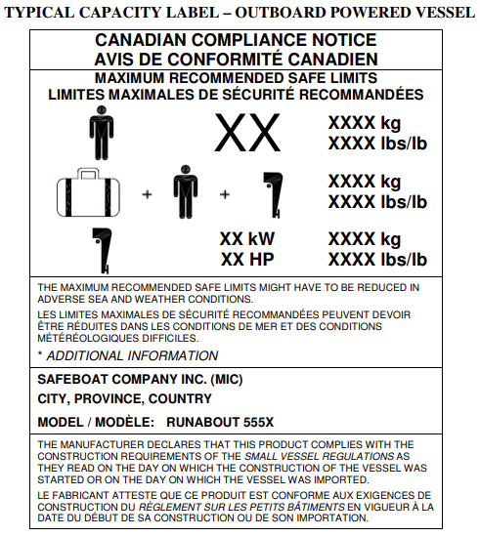
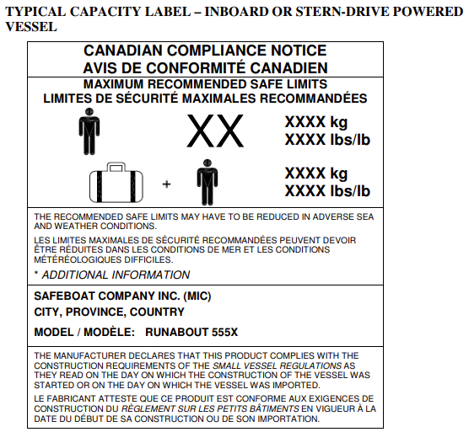
FVRS Phase II – Part 5 - New Vessels Documentation and Serial Numbers

Slide 6
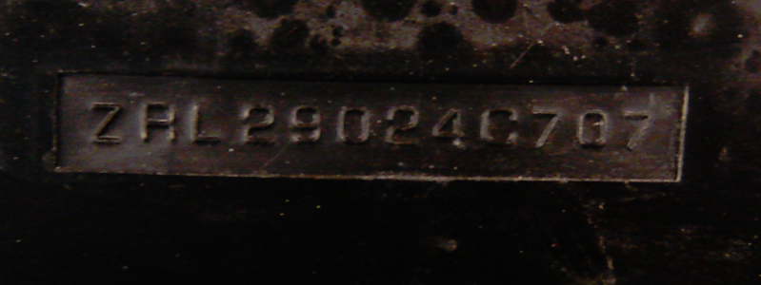
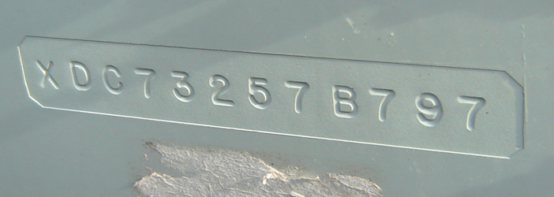
FVRS Phase II – Part 5 - New Vessels Documentation and Serial Numbers
Hull Serial Number (HIN)
Unique identifier for each vessel
Attestation vessel meets requirements.
Obtain a Manufactures Identification Code (MIC)
Permanently affixed
2nd Hidden HIN
Kit boats must add a suffix to the HIN.
Documents kept for 7 years.

Slide 7
Current FVSR - Scope
Part 0.1
Commercial fishing vessels not exceeding 24.4 m in length or 150 gross tonnage.
Part I
Commercial fishing vessels exceeding 15 gross tonnage but not exceeding 24.4 m in length or 150 gross tonnage. (Certificated).
Part II
Commercial fishing vessels not exceeding 15 gross tonnage.
Notes:
Explanation of new FVSR layout
Remember Part 0.1 is 0 to 150GT (or 24.4m in Length) – To be clear, ALL vessels.
Part I – over 15GT
Part II – Under 15GT
Explain that there is very little change in Parts I & II only administratively. More internal changes for TC such as TC is no longer inspecting fuel tanks, etc.
This is a good time (if you have time) to add a part about Phase II of the FVSR implementation – Phase II will address FV construction up to 150GT and if anyone wants to be involved, they can by signing up to or attending CMAC.

Slide 8
Responsibilities
The Canada Shipping Act, 2001 outlines the vessel owner's obligations for understanding the regulatory requirements that apply to their vessel / operation, and for ensuring they comply at all times. (ref CSA 2001 s.106)
From FVSR
Responsibility
3.02 Unless otherwise indicated in this Part, the authorized representative (AR - aka Owner) and the master of a fishing vessel shall ensure that the requirements of this Part are met.
Notes:
Emphasize CSA 2001 section 106 – AR (aka owner) is responsible to ensure compliance! Which is further emphasized in FVSR 3.02
Better to call TC and ask for assistance then be boarded during fishing season and be tied to the wharf while waiting for things to be fixed / ordered / etc. before they can fish again.
Possible Comment / Question:
“So I am responsible to understand all of this information? I’m not a TC inspector!”, or
“I can’t read, how can I understand all of that!”
Suggested Response:
That responsibility has been in the Canada Shipping Act 2001 since July 2007, this is not new.
That’s why I (you / we) are here today, to help you better understand the requirements and answer your questions.
TC is always available to help and assist with interpreting regulations. (send them to Rob Freake if necessary)
For technical application to the vessel, Marine Consultants can be hired to help. (such as stability)

Slide 9
Responsibilities
The AR is responsible to ensure Safe Operation of the vessel by:
  Ensuring it is designed, constructed and equipped to operate safely and be seaworthy in its area of operation (s.3.03)
  Not exceeding design limitations (s.3.07)
  Not operating carelessly (s.3.08)
  Not jeopardizing safety: Lifejackets/PFD’s to be worn in conditions that could jeopardize safety (s.3.09)
Notes:
Freezing spray warnings – good opportunity to reference Stability. If stability is completed and icing is included, this restriction will not be placed on the vessel.
Not exceeding design limitations / Not operating carelessly – Reference over loading.
Not jeopardizing safety: Lifejackets/PFD’s to be worn in conditions that could jeopardize safety – Each province is different (NB / NS/ PE/ NL) when considering Provincial OHS requirements. We can provide guidance and a contact on that if necessary.

Slide 10
Duties of the Master (CSA 2001 s.107 – s.112)
Safety of persons
Protection from hazards
Obtaining Canadian maritime documents
Carrying excess number of persons
Direction to cease — master
Direction to take measures — master
Information to be sent respecting dangers to navigation
Notes:
Customize your thoughts and phrases on this but here is what I use:
TSB is an independent department that oversees transportation safety and investigates transportation accidents in Canada. When they identify an area that they determine requires attention, they include it in their Watchlist that is updated from time to time. Once a Watchlist is published, TC typically responds and makes efforts to address those concerns via regulations, SSBs, etc. In this case, the FVSR has been drafted to include the optional use of PFDs (or LJs) when there is a possibility of drowning (jeopardizing safety).
It is expected that these statistics will decrease since they were established prior to the coming into force of the FVSR (July 13th, 2017)
TC is the “meat in the sandwich” here. TSB recommends new requirements and TC implements those in conjunction with public consultations. If the public rejected these, then they may only be implemented in part. The best way to prevent this from happening is to not have accidents, so TSB is not involved!

Slide 11
Duties of the Crew (CSA 2001 s.1113 – s.114
Carrying out duties and reporting
not jeopardize the safety of the vessel or of any person on board;
report to the master any safety hazards of which they become aware;
report any change in their circumstances that could affect their ability to carry out their duties and functions safely; and
comply with lawful directions given by the master.
Direction to cease — crew (Direction to stop an unsafe operation)

Slide 12
Addressing Known Safety Risks
2022 Transportation Safety Board (TSB) Watchlist
Despite various initiatives that have sparked the development of a safety culture within the commercial fishing industry, the same safety deficiencies on board fishing vessels continue to put the lives of thousands of Canadian fish harvesters at risk.
From July 2020 to June 2022, there were 19 fatalities related to commercial fishing in Canada. The number of fish harvesters that lose their lives annually has not decreased, and continues to average about 11 per year, making harvesting marine resources one of the most hazardous occupations in the country. The vast majority of these fatalities were preventable.
Notes:
Customize your thoughts and phrases on this but here is what I use:
TSB is an independent department that oversees transportation safety and investigates transportation accidents in Canada. When they identify an area that they determine requires attention, they include it in their Watchlist that is updated from time to time. Once a Watchlist is published, TC typically responds and makes efforts to address those concerns via regulations, SSBs, etc. In this case, the FVSR has been drafted to include the optional use of PFDs (or LJs) when there is a possibility of drowning (jeopardizing safety).
It is expected that these statistics will decrease since they were established prior to the coming into force of the FVSR (July 13th, 2017)
TC is the “meat in the sandwich” here. TSB recommends new requirements and TC implements those in conjunction with public consultations. If the public rejected these, then they may only be implemented in part. The best way to prevent this from happening is to not have accidents, so TSB is not involved!

Slide 13
Addressing Known Safety Risks
To reduce the risk of accidents and deaths the FVSR requires:
The use of PFDs, when safety may be jeopardized
Written safety procedures (Enforcement)
Record keeping (Modifications / Drills / Maintenance)
Safety Equipment based on vessel length and voyage
Stability assessments for new vessels
Adequate stability for existing vessels
Stability Notices for all vessel assessed
Notes:
Written Procedures have been developed by TC, for use by industry and can be found at - https://www.tc.gc.ca/eng/marinesafety/debs-fishing-vessels-small-menu-4526.html#templates
OR google “Small Fishing Vessel Safety” and follow the links.
Will also find templates for: Record of Mods / Drills / Maintenance
Stability:
It is / was not the intention of TC to capture all vessels (existing) in the new requirement to have a stability Assessment conducted.
That said, exiting vessels (built prior to July 13th, 2018) require adequate stability. These will be dealt with on case-by-case basis and any obvious stability “triggers” would require an assessment
Stability Notice should have a positive spin as being a great addition for operators. Explain it as a picture explanation of the stability assessment, posted for all to see and understand.
Example in three (3) more slides.

Slide 14
Statutory Requirement
  For vessels over 15 GT, Periodic Inspections and Certification are required.
  Vessels 15GT and less, do not required an inspection or certificate, but are still required to comply with the applicable regulations.
  *Note: Owners can meet this obligation by participating in the Small Vessel Compliance Program for Fishing Vessel (SVCP-F)
Notes:
Just a reminder that over 15GT gets an Inspection every four (4) years, under 15GT doesn’t.
Good chance to discuss the SVCP-F
DCR
Guidance Notes
Monitoring Inspections
Remember CSA 2001 – section 106 & FVSR section 3.02 (AR Responsible)
Can be very quick slide if time is a factor or you are addressing a specific group (i.e. Only over / under 15GT fleet)

Slide 15

Small Vessel Compliance Program
Fishing Vessels (SVCP-F)
  SVCP-F is a program that will provide owners and operators of small fishing vessels with tools and guidelines to help them meet their obligations, to comply with regulations, made under the Canada Shipping Act 2001.
  SVCP-F documents can be found on-line and completed checklists can be submitted electronically.
Notes:
Here is what you get when you are successfully enrolled in the SVCP-F
Popular Program
Helps ensure owner obligations are met (CSA 2001 s.106 & FVSR s.3.02)
Helps enforcement people know who has brought their vessels up to standards.
Most times vessels fitted with a orange decal will not be monitored but will at sometime to ensure the verification was correct and accurate. (Not seeing a TC inspector is a selling point in some places!)

Slide 16
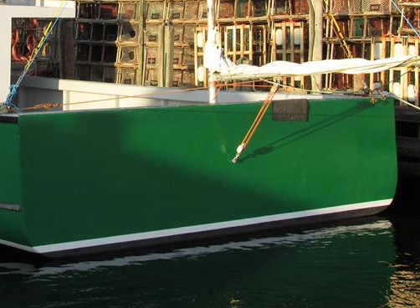
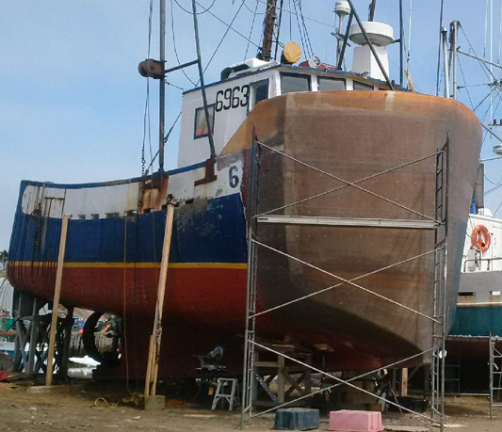
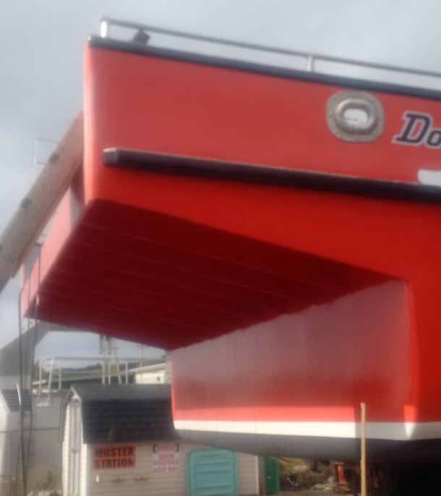
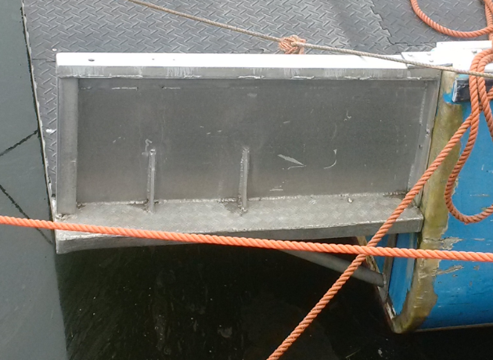
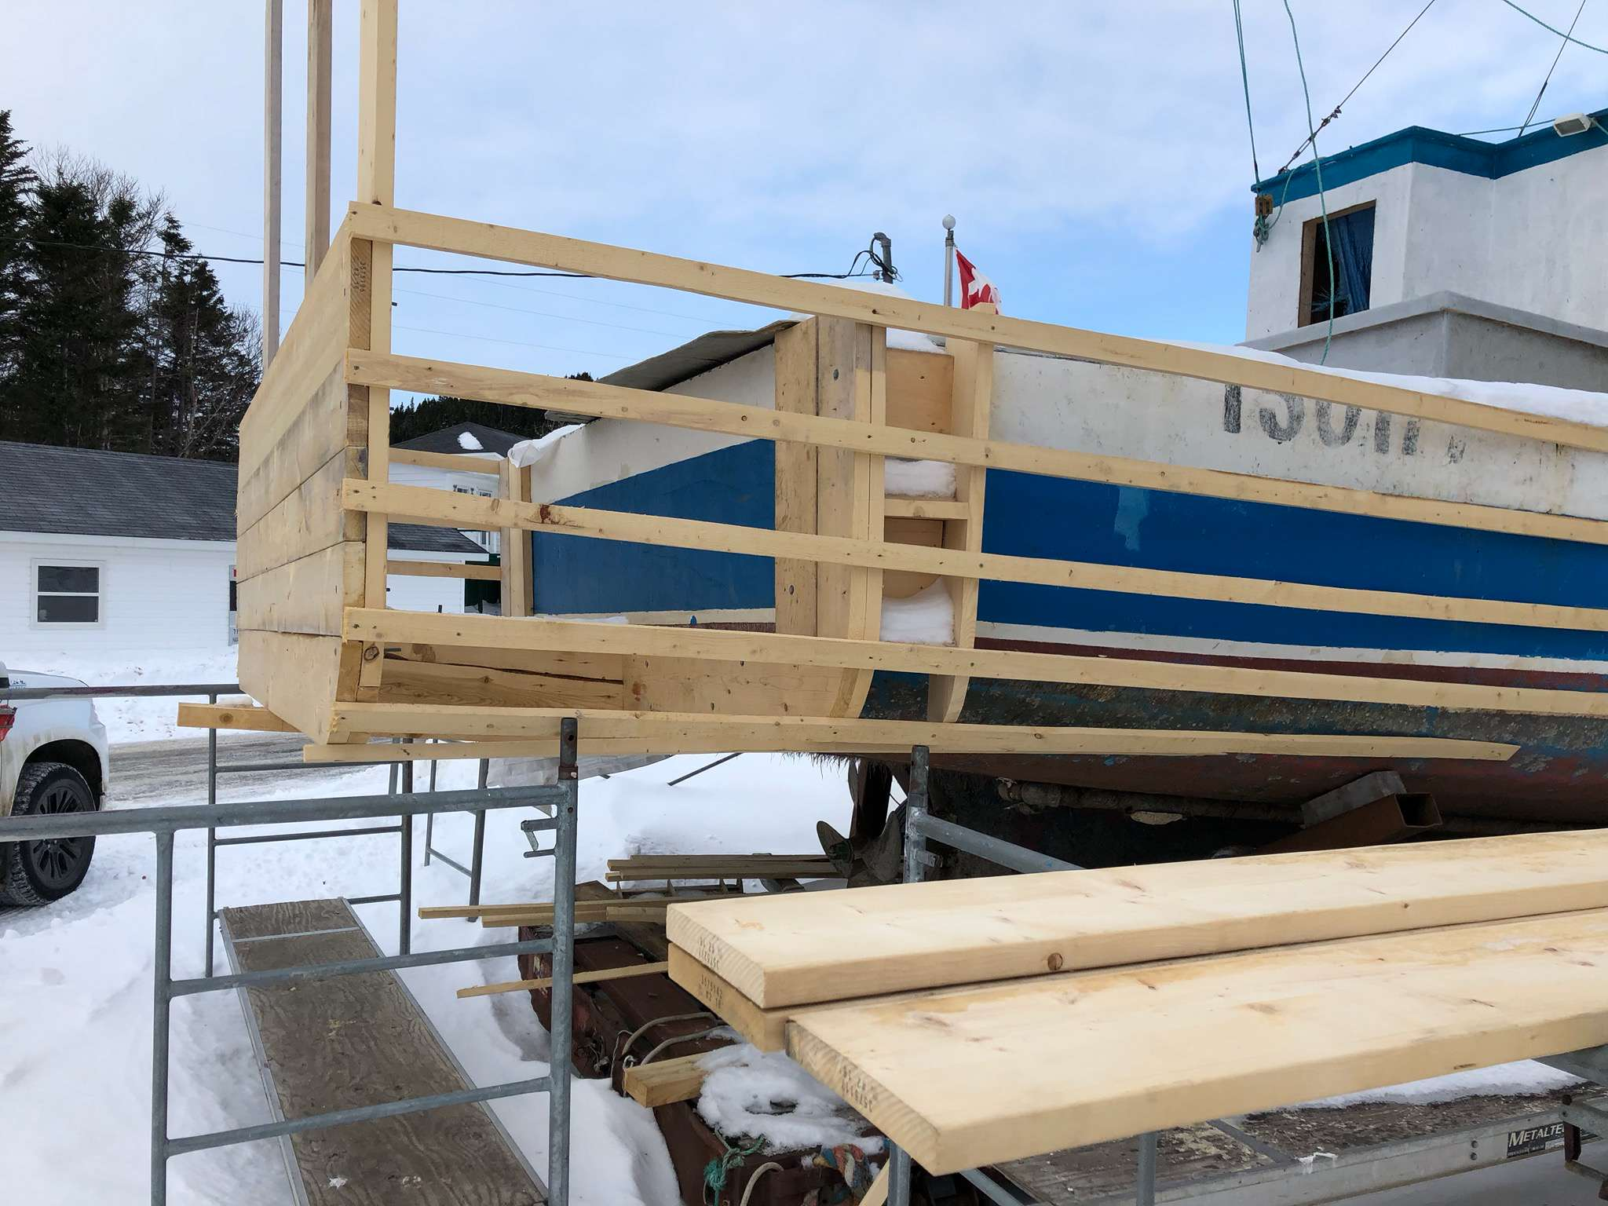
Key Definitions
  New (July 13th, 2018)
  Hull Length
  Major Modification
Notes:
Lots of new definitions, but here are a few KEY definitions that are needed in order to navigate the FVSR properly.
New or (New) New as it is easily remembered – ONLY applicable to stability. For vessels built or build contract in place prior to July 13th, 2018
Hull Length – Basically LOA, more specifically (use hull extension, bulbous bow, bow sprit, etc. as an example) – if (example) can be removed with hand tools then NOT part of hull length, if it CANNOT be easily removed with hand tools (welded or FRP/GRP’ed) into place) then it IS part of Hull Length.
REMINDER that hull length is used to determine requirements in Part 0.1 and will be used in Phase II FVSR, replacing (Old) New (built after 1965) when phase II comes into force.
Major Modification – An example: A vessel rebuilt back to EXACTLY the same as it was previous is NOT considered a major mod. If vessel rebuilt where Bhds are moved, WH bigger, deck raised, etc. This is a major mod and MAY trigger stability.
Good Opportunity to briefly discuss TP15392 - Guidelines for fishing vessel major modification or a change in activity.
https://www.tc.gc.ca/eng/marinesafety/tp15392e-guidelines-fishing-vessel-major-modification-change-activity.html

Slide 17
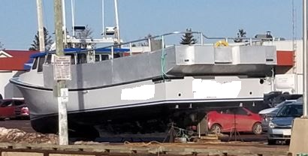
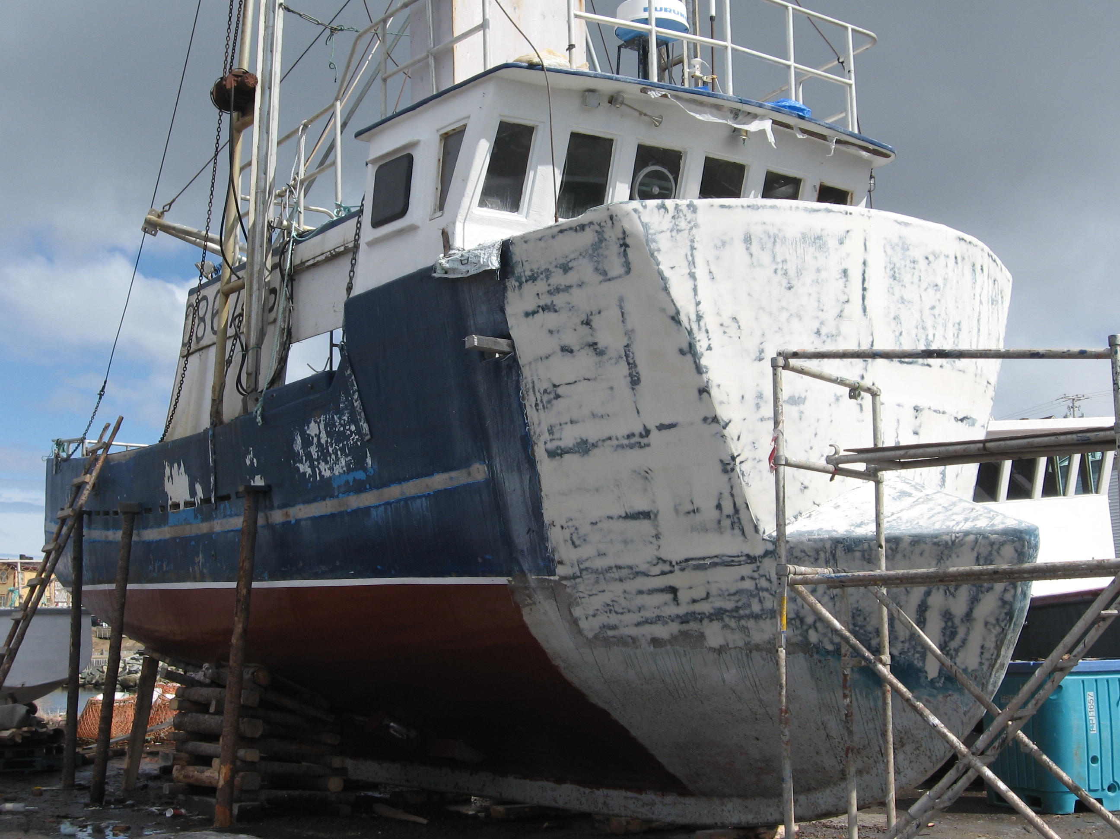
Major Modification Definition
Major Modification
FVSR s.3.48(3) In this section, major modification means a modification or repair, or a series of modifications or repairs, that substantially changes the capacity or size of a fishing vessel or the nature of a system on board a fishing vessel, that affects its watertight integrity or its stability.

Slide 18
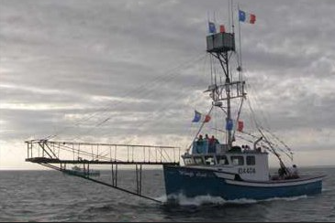
Major Modification Definition
Change in Activity
A change to a fishing activity may have a negative impact on your fishing vessel’s stability and the forces acting on your fishing vessel may change.
Before undertaking any change in fishing activity, consideration should be given to the potential effects that it could have on the vessel’s stability characteristics.
TP 15392E - Guidelines for fishing vessel major modification or a change in activity

Slide 19
Stability
  Required for all fishing vessels built after July 13th, 2018
  Existing fishing vessels (built prior to July 13th, 2018) stability shall be adequate to safely carry out the vessel’s intended operations
  Any vessel that undergoes a Major Modification that affects it stability is required to undergo a stability assessment.
Notes:
Lots of new definitions, but here are a few KEY definitions that are needed in order to navigate the FVSR properly.
New or (New) New as it is easily remembered – ONLY applicable to stability. For vessels built or build contract in place prior to July 13th, 2018
Hull Length – Basically LOA, more specifically (use hull extension, bulbous bow, bow sprit, etc. as an example) – if (example) can be removed with hand tools then NOT part of hull length, if it CANNOT be easily removed with hand tools (welded or FRP/GRP’ed) into place) then it IS part of Hull Length.
REMINDER that hull length is used to determine requirements in Part 0.1 and will be used in Phase II FVSR, replacing (Old) New (built after 1965) when phase II comes into force.
Major Modification – An example: A vessel rebuilt back to EXACTLY the same as it was previous is NOT considered a major mod. If vessel rebuilt where Bhds are moved, WH bigger, deck raised, etc. This is a major mod and MAY trigger stability.
Good Opportunity to briefly discuss TP15392 - Guidelines for fishing vessel major modification or a change in activity.
https://www.tc.gc.ca/eng/marinesafety/tp15392e-guidelines-fishing-vessel-major-modification-change-activity.html

Slide 20
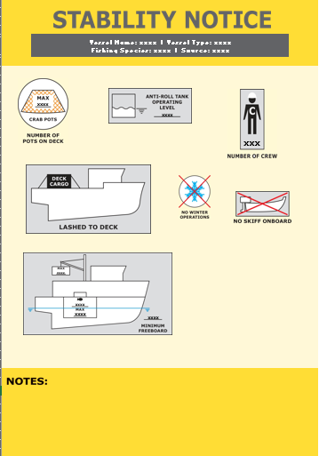
Stability
Notes:
Lots of new definitions, but here are a few KEY definitions that are needed in order to navigate the FVSR properly.
New or (New) New as it is easily remembered – ONLY applicable to stability. For vessels built or build contract in place prior to July 13th, 2018
Hull Length – Basically LOA, more specifically (use hull extension, bulbous bow, bow sprit, etc. as an example) – if (example) can be removed with hand tools then NOT part of hull length, if it CANNOT be easily removed with hand tools (welded or FRP/GRP’ed) into place) then it IS part of Hull Length.
REMINDER that hull length is used to determine requirements in Part 0.1 and will be used in Phase II FVSR, replacing (Old) New (built after 1965) when phase II comes into force.
Major Modification – An example: A vessel rebuilt back to EXACTLY the same as it was previous is NOT considered a major mod. If vessel rebuilt where Bhds are moved, WH bigger, deck raised, etc. This is a major mod and MAY trigger stability.
Good Opportunity to briefly discuss TP15392 - Guidelines for fishing vessel major modification or a change in activity.
https://www.tc.gc.ca/eng/marinesafety/tp15392e-guidelines-fishing-vessel-major-modification-change-activity.html

Slide 21
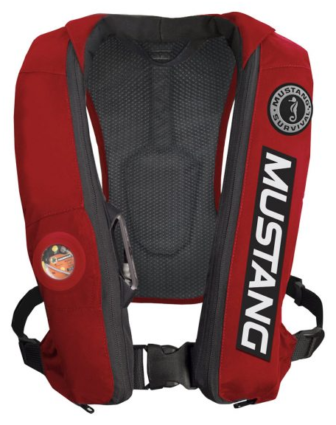
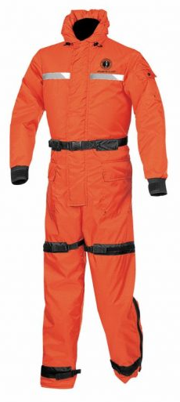
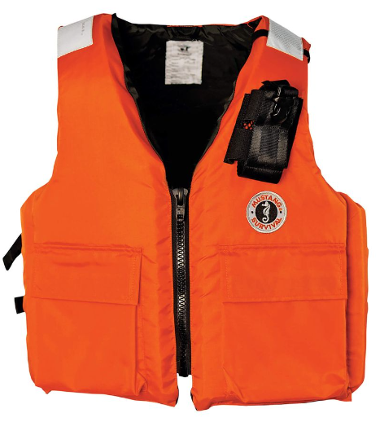
Personal Floatation Devices (PFD)
  No person shall operate, or permit another person to operate, a fishing vessel in environmental conditions or circumstances that could jeopardize the safety of persons on board unless a lifejacket required by this Part, or a personal flotation device is worn.
  by all persons on board, if the vessel has no deck or deck structure; or
  by all persons on the deck, in the case of a vessel that has a deck or deck structure.
  PFDs shall be marked with either:
  CAN/CGSB-65.11-M88, or
  UL 1180
  Level 70 (NEW)
  Also, the PFD on a Fishing Vessel shall;
  Be fitted with retro-reflective tape and a whistle
  have an outer covering of a highly visible colour
Notes:
Just a reminder that over 15GT gets an Inspection every four (4) years, under 15GT doesn’t.
Good chance to discuss the SVCP-F
DCR
Guidance Notes
Monitoring Inspections
Remember CSA 2001 – section 106 & FVSR section 3.02 (AR Responsible)
Can be very quick slide if time is a factor or you are addressing a specific group (i.e. Only over / under 15GT fleet)

Slide 22
Vessel Registration
All vessels are required to be registered (w/ exceptions) – CSA 2001 s.46
All vessels are required to be marked (with registration #) – CSA2001 s.57
Registration process completed on-line (Google Transport Canada Vessel Registration)

Slide 23
Vessel Registration
Canadian Register of Vessels (Large Vessel)
You are required to register a vessel in the Canadian Register of Vessels if:
15 GT or more and powered by engines totaling 7.5 kW (10 horsepower) or more
will have a marine mortgage
needs a reserved name
will travel outside of Canada
Valid for 5 years
Requires renewal application

Slide 24
Vessel Registration
Small Commercial Registry of Vessels
Applicable to vessels gross tonnage of 15 or less
No unique name (ex. C12345NS)
Valid for 5 years
Requires Renewal Application

Slide 25
Compliance & Enforcement
TCMSS works directly with vessel owners to bring vessels to compliance, sometimes through enforcement.
TC takes a measured approach to enforcement. We begin with verbal and written guidance for regulator non-compliance and moves to formal deficiency notices with due dates to rectify deficiencies.
Occasionally, for safety reasons, non-compliant vessels may not be allowed to sail until the deficiencies are corrected and meet all applicable regulations.
TC requirements may get updated at any time. TC encourages vessel owners to consult with TC when considering or undertaking modifications to a vessel to ensure their safety and compliance with regulations
The enforcement action of issuing an administrative monetary penalty is the final recourse.

Slide 26
Other Points of Interest …
  Assigned Formal Tonnage (AFT)
  Being phased out and ends on July 1st, 2026 (ref: SSB 15/2023)
  Results don’t accurately reflect a vessel’s size.
  Vessels that register before July 1, 2026, and use the AFT can keep their tonnage.
  If the vessel is modified that changes its tonnage by more than 5% after July 1, 2026, then another method of GT determination must be used.
  Simplified Method of Tonnage Measurement
  Tonnage Measurer.

Slide 27
Other Points of Interest …
  How to measure Hull Length
The measurement must be taken between two vertical planes: one at the foremost part of the hull and the other through the aftermost part of the hull. Hull length includes all structural and integral parts of the vessel, such as bulwarks and hull / deck extensions.
Any extension or component that is integrally formed, molded or welded to the vessel is considered part of the hull shell and is included in the length, even if it doesn’t add to buoyancy. This includes:
Bulbous Bow
Deck Extension
Anchor Roller
Integrally formed means: "connected to make up a single complete piece or unit and is incapable of being easily dismantled without destroying the integrity of the piece or unit"

Slide 28
Next Steps
  Phase II of the FVSR is currently being consulted on through the Canadian Maritime Advisory Council (CMAC) process.
  Phase II of the FVSR will;
  address fishing vessel construction up to 24.4m in length or 150GT.
  address existing vessels through Critical Safety Elements and TSB recommendations.
  Is expected to enter Canada Gazette Part I in late 2026 for 60 days then have a 1-year phase in period.
Notes:
As discussed in part in past slides

Slide 29
Next Steps
To accommodate the new regulations, Transport Canada has updated its Small Fishing Vessel Safety webpage links
https://www.tc.gc.ca/eng/marinesafety/debs-fishing-vessels-small-menu-292.htm
Authorized Representatives should visit the webpage to stay up to date with the latest information. (Google Search – Small Fishing Vessel Safety)
  Small fishing vessels’ Authorized Representatives should become familiar with the new requirements and take the necessary steps to ensure they are in compliance.
Notes:
Explain – this new website is good and not cumbersome like others. It is up to date as new info comes available and is best to find via google.
Explanation of Bolded Text – Intended to again reiterate that owners, operators and crews are responsible and should take the time to read and understand the FVSR. Any questions regarding the FVSR can be sent to Rob Freake (902-222-3900 or rob.freake@tc.gc.ca) or yourself if you are ok with that.

Slide 30
Fishing Vessel Safety Regulations
  Please do not hesitate to contact your local Transport Canada Centre if you have any questions.
  Thank you !
  Rob Freake – Atlantic Fishing Vessel Representative for TCMSS.
  Rob.Freake@tc.gc.ca

